Slide 1
Islamic Philosophy of Ethics and Moral Behaviors

Slide 2
Surat-ul-Hujurat (سورۃ الحجرات)
Translation
Chapter # 49
Total verses - 18
Revealed in Madinah

Slide 3
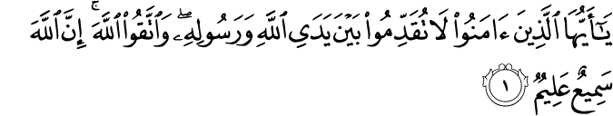
Manners regarding Prophet Muhammad ﷺ, and as well as for parents, teachers and elders: Avoid to proceed ahead of Prophet ﷺ, in walking or talking.
O you who believe, do not proceed ahead of Allah and His Prophet and fear Allah. Surely Allah is All-Hearing, All-Knowing.

Slide 4
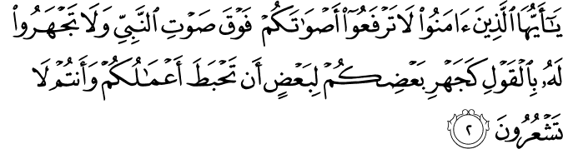
Avoid to raise voice in front of him ﷺ
O you who believe, do not raise your voices above the voice of the Prophet, and be not loud when speaking to him, as you are loud when speaking to one another, lest your good deeds should become void while you are not aware.

Slide 5
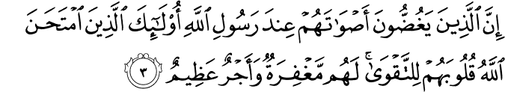
Appreciation to submission of believers.
Surely, those who lower their voices before Allah’s Messenger are the ones whose hearts Allah has tested for piety; for them there is forgiveness, and a great reward.

Slide 6
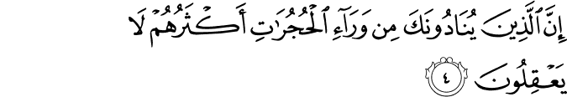
Avoid to Call him in the relaxation time Call him from outside the house and Call him by his name.
As for those who call you from behind the chambers, most of them have no sense.

Slide 7
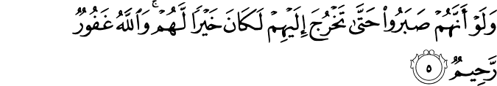
Solution: They should have waited until the prophet ﷺ himself came out of the house.
Had they remained patient until you come out to them, it would have been much better for them. And Allah is Most-Forgiving, Very-Merciful.

Slide 8
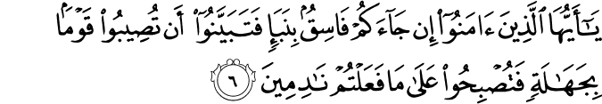
Verifying the report of any person or rumors
O you who believe, if a sinful person brings you a report, verify its correctness, lest you should harm a people out of ignorance, and then become remorseful on what you did.

Slide 9
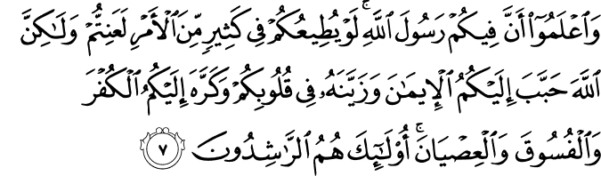
Importance of consultation. (مشاورت) and its ways.
7. And know that among you there is the Messenger of Allah. If he obeys you in many a matter, you will certainly fall into hardship. But Allah has endeared to you the Faith, and made it beautiful in your hearts, and made detestable to you the disbelief and sins and disobedience. Such people are rightly guided,

Slide 10
As a grace from Allah, and as a blessing. And Allah is all-knowing, all-wise.

Slide 11
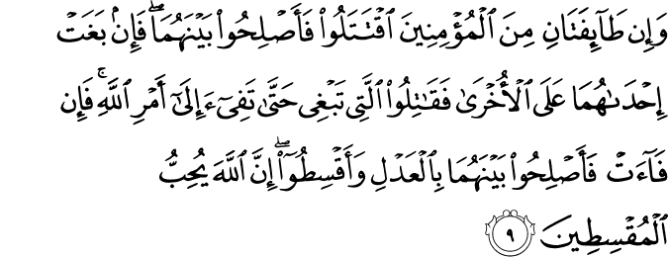
Reconciliation between Muslims
If two groups of the believers fight each other, see reconciliation between them.
And if one of them commits aggression against the other, fight the one that commits aggression until it comes back to Allah’s command.
So if it comes back, seek reconciliation between them with fairness, and maintain justice.
Surely Allah loves those who maintain justice.

Slide 12
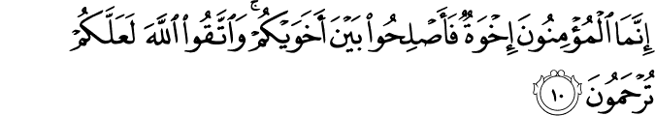
All Muslims are Brothers.
All believers are but brothers, therefore seek reconciliation between your two brothers, and fear Allah, so that you may be blessed with mercy.

Slide 13
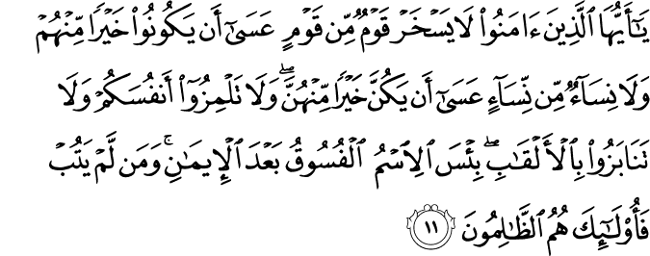
Avoid to scoff with each other.(مزاق اڑانا) Avoid to Finding fault with each other. (عیب تلاش کرنا) Avoid to call each other by bad nicknames. (برے لقب سے پکارنا)
O you who believe, no men should ever scoff at other men. May be, the latter are better than the former. Nor should women (ever scoff) at other women. May be, the latter women are better than the former ones.
And do not find fault with one another,
nor call one another with bad nicknames. Bad is the name of sinfulness after embracing Faith. If anyone does not repent, then such people are the wrongdoers.

Slide 14
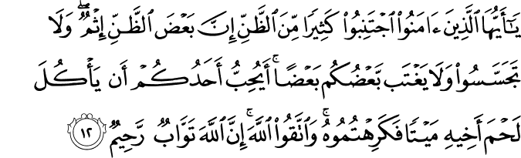
Avoid Suspicions.(بد گمانی) Avoid Spying. (جاسوسی) Avoid Back biting. (غیبت)
O you who believe, abstain from many of the suspicions. Some suspicions are sins.
And do not be curious (do not spy)
And do not backbite one another. Does one of you like that he eats the flesh of his dead brother? You would abhor it. And fear Allah. Surely Allah is Most-Relenting, Very-Merciful.

Slide 15
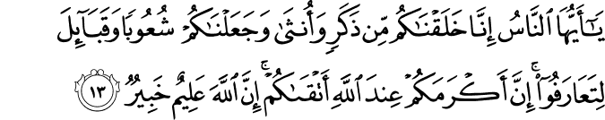
Islam and Racism Importance of piety Status of tribes or families
O mankind, We have created you from a male and a female, and made you into races and tribes, so that you may identify one another.
Surely the noblest of you, in Allah’s sight, is the one who is most pious of you. Surely Allah is All-Knowing, All-Aware.

Slide 16
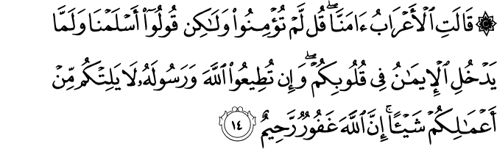
Islam is submission
Iman is belief
The Bedouins say, “We have come to believe.” Say, “You have not com to believe; instead, you (should) say We have surrendered’ and the belie has not entered your hearts so far. If you obey Allah and His Messenger, He will not curtail (the reward of) an of your deeds in the least. Surely Allah is Most-Forgiving, Very-Merciful.”

Slide 17
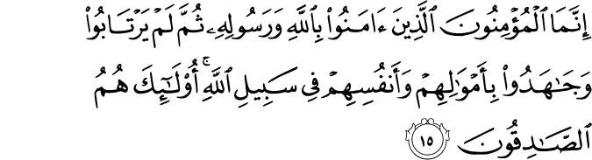
Believers, in fact, are those who believe in Allah and His Messenger, then have no doubt, and struggle, with their riches and their lives, in the way of Allah. Those are the truthful.

Slide 18
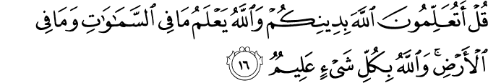
Say, “Would you apprise Allah of your religion, while Allah knows all that is in the heavens and all that is in the earth, and Allah is All-Knowing about every thing?”

Slide 19
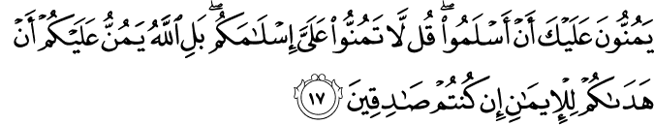
They oblige you that they have accepted Islam, (as if it was a favor shown to you). Say, “Do not oblige me for your accepting Islam. Rather, Allah makes you obliged for His having guided you to the Faith, if you are truthful.

Slide 20
Surely Allah knows the Unseen of the heavens and the earth, and Allah keeps in sight whatever you do.

